Slide 1
Image Quilting for Texture Synthesis
Digital Image Processing (ECL 410)
Submitted to: Dr. Ghanpriya Singh
Presenting by:
Aditi Pathak
Etamsetty Hari Sai Raju

Slide 2
Objective
Idea: Transition from mostly texture to mostly target figure
Vary resemblance to texture/target
Change window size with
Blur input target
Add time dimension to state information:
Consider texture from previous frame

Slide 3
Algorithm & Implementation Pipeline
We use Quilting as a texture synthesis and texture transfer algorithm which surprisingly produces good result for a wide range of textures.
Then we will be extending the algorithm to perform texture transfer- rendering an object with a texture taken from a different object.
We demonstrate how an image can be re-rendered in the style of a different image.

Slide 4
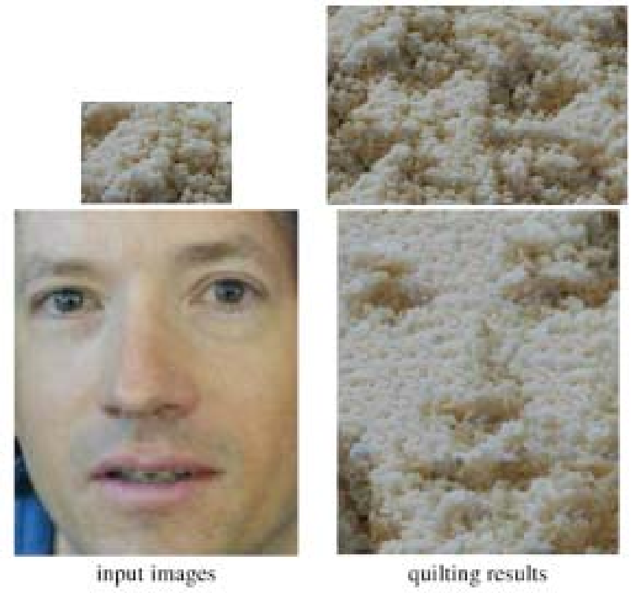
The Image Quilting Algorithm
The image to be synthesized in raster scan order of one block (minus the overlap).
For every location, search the input texture for a set of blocks that satisfy the overlap constraints (above and left) within some error tolerance. Randomly pick one such block.
Compute the error surface between the newly chosen block and the old blocks at the overlap region. Find the minimum cost path along this surface and make the boundary of the new block. Paste the block onto the texture.
REPEAT.

Slide 5
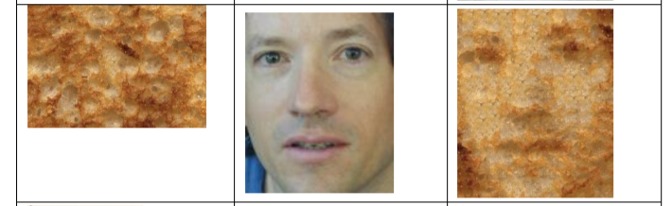
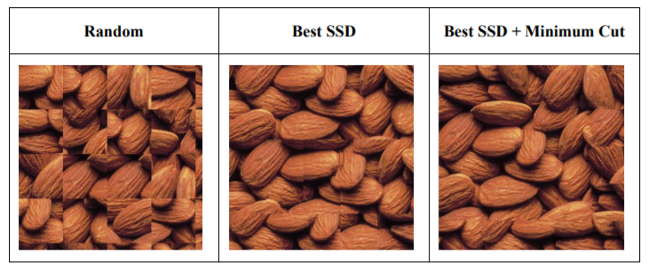
Texture Synthesis and Transfer
Texture Synthesis
Patch selection
Calculating the error surface
Determine minimum cost boundary cut
Texture Transfer
Maintaining minimum match error with previously selected patches on the overlapping region
Sampled patch should has small correspondence error with the target image at the desired position

Slide 6

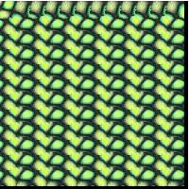
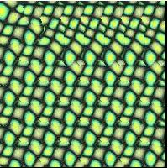
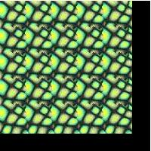
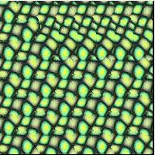
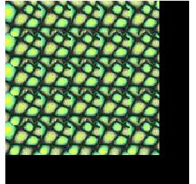
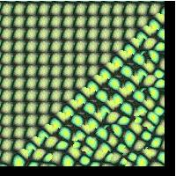
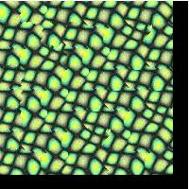
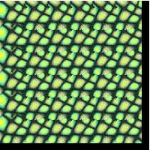
Dependency on Sampling Parameters
20 pixel Window
30 pixel Window
40 pixel Window
Input:
1/6
Overlap
1/5
Overlap
1/4
Overlap

Slide 7
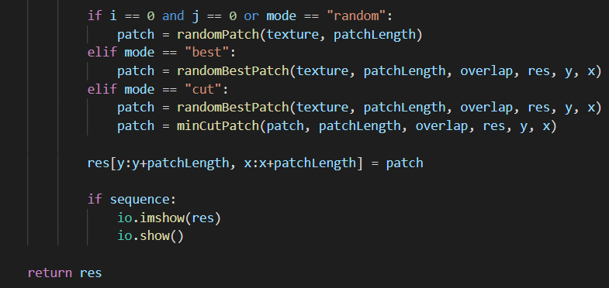
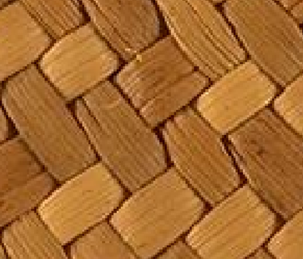
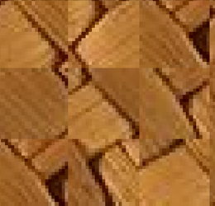
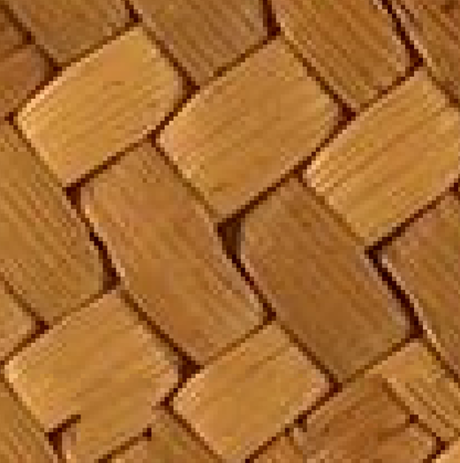
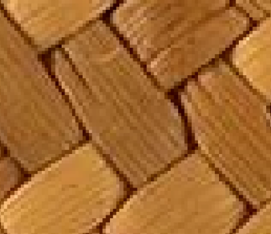
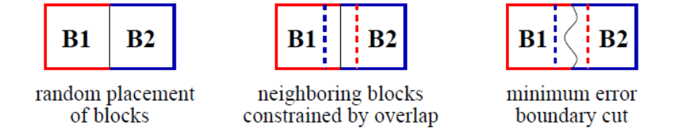
Results / Outputs
Mode is selected as ‘random’;’best’;’cut’ where random patch is selected and then random best patch is selected respectively and then the minCutPatch functions determines the minimum error boundary cut between adjacents patch(s)

Slide 8
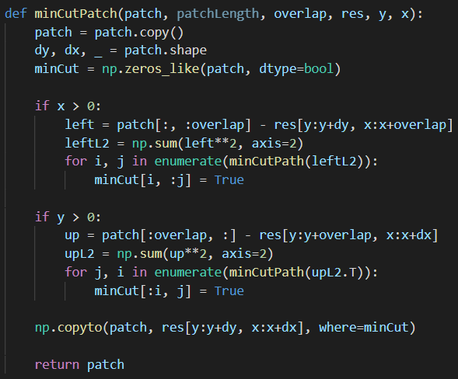
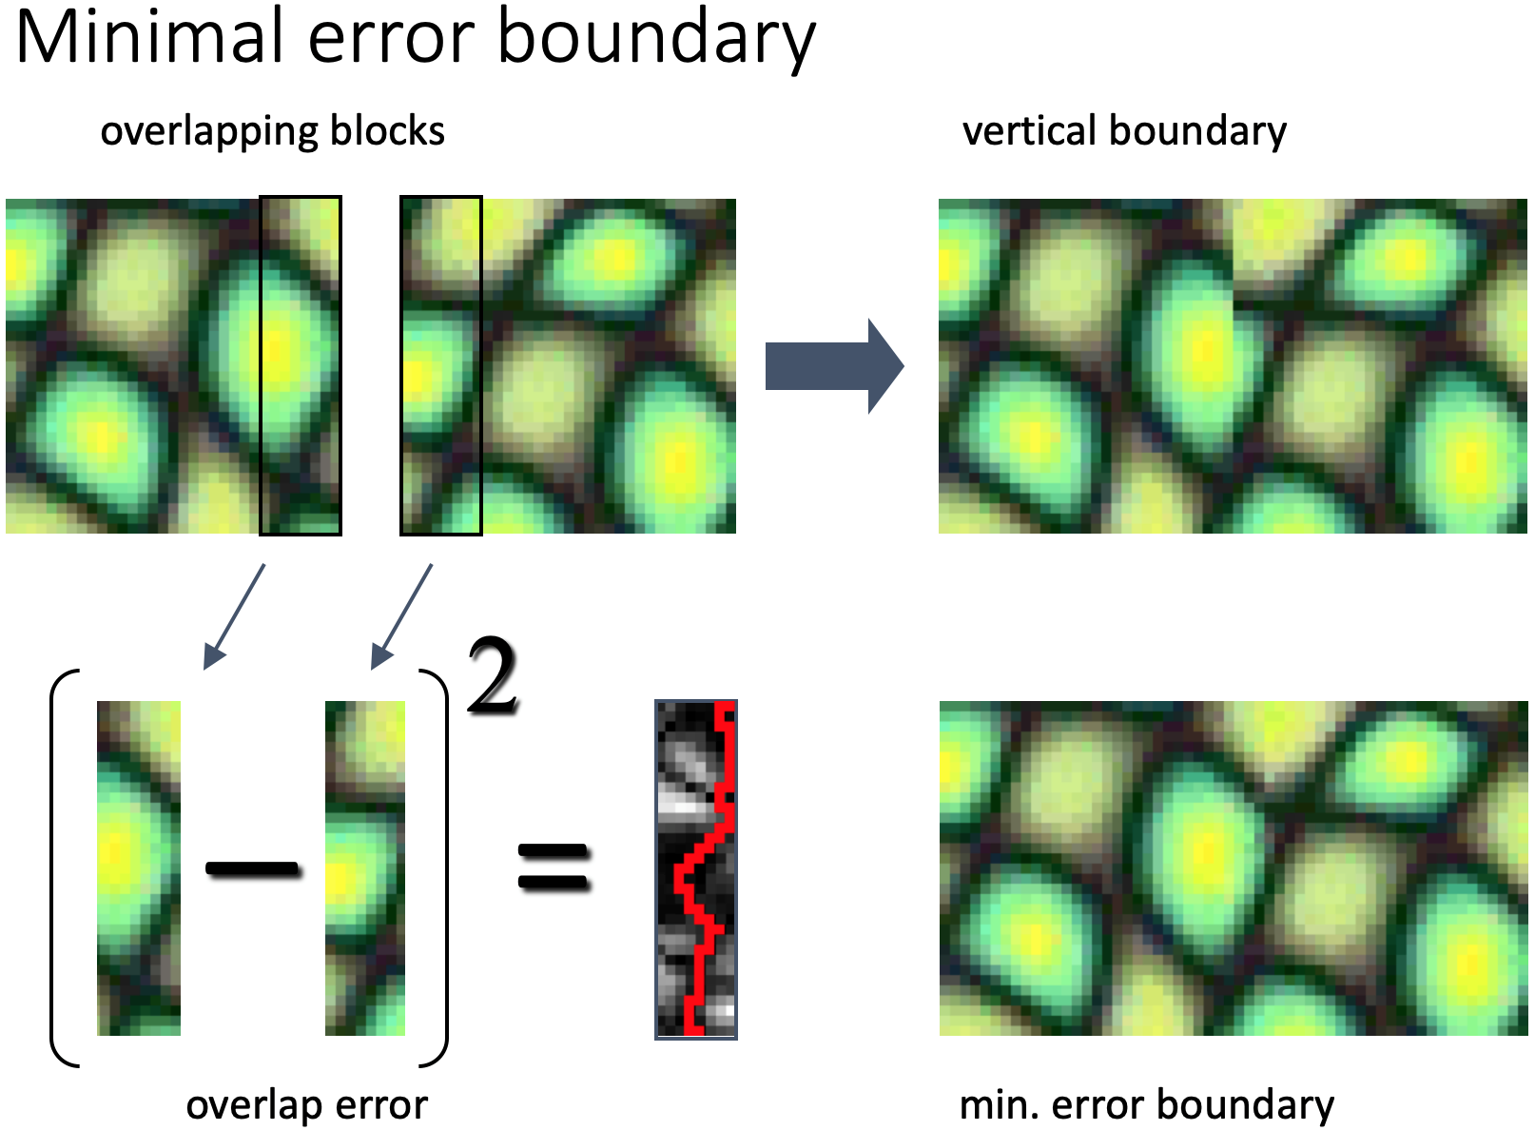
Results / Outputs
minCutPatch() functions determines the minimum error boundary cut between adjacent patch(s).

Slide 9
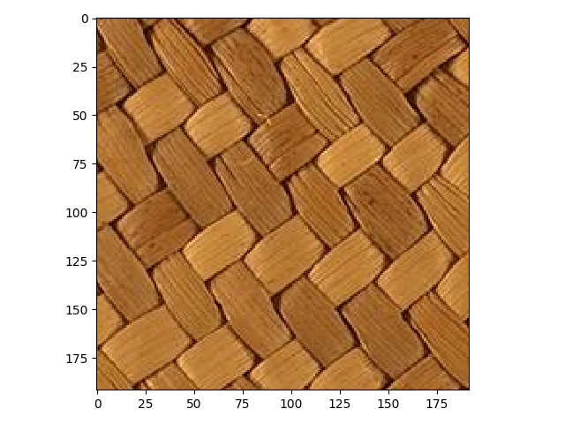
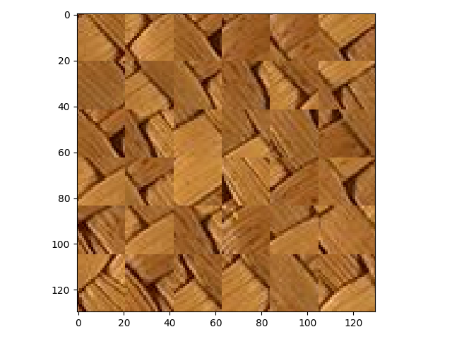
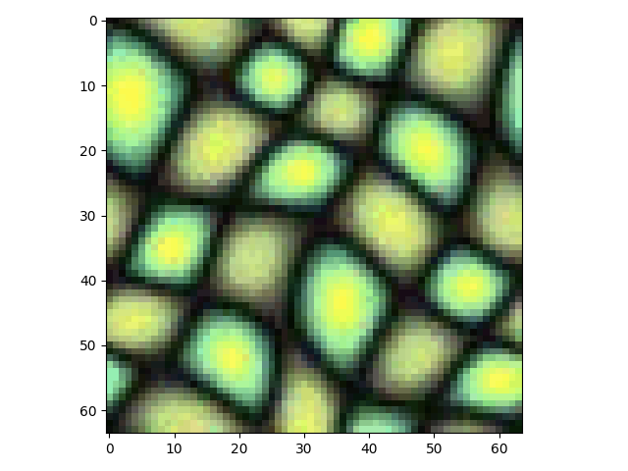
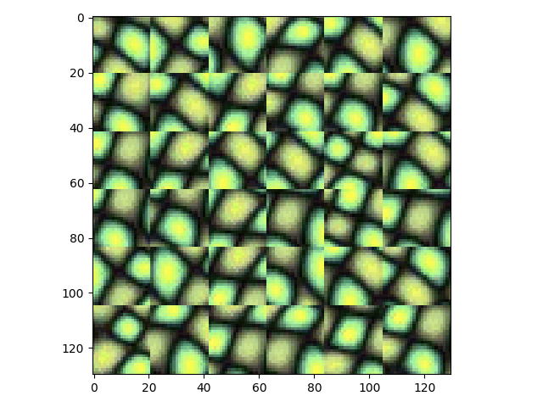
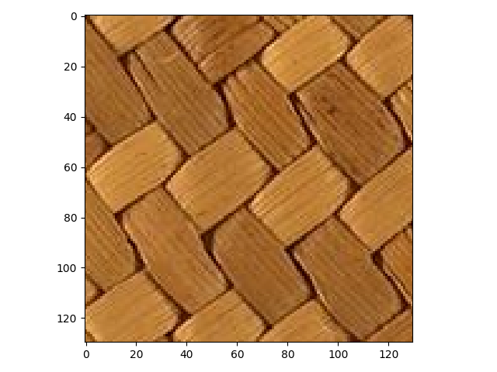
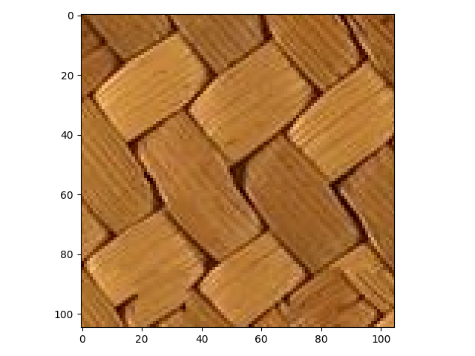
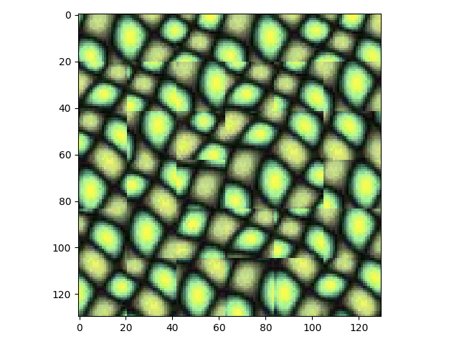
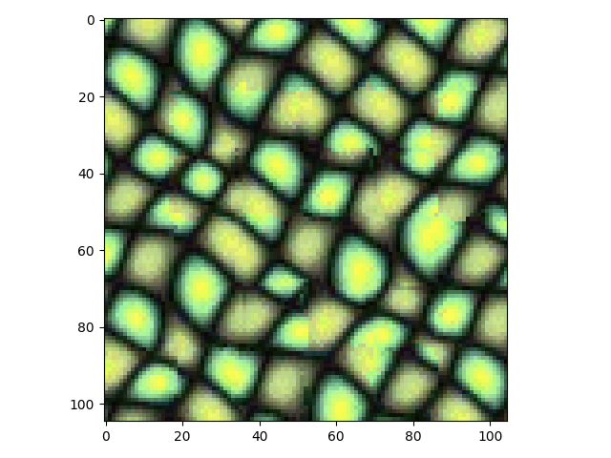
Results / Outputs
Texture Transfer by Image Quilting algorithm

Slide 10
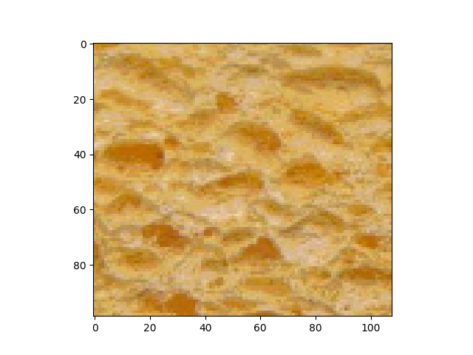
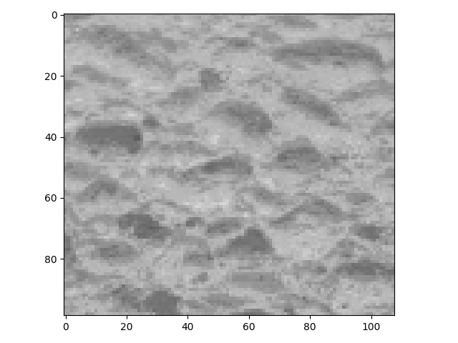
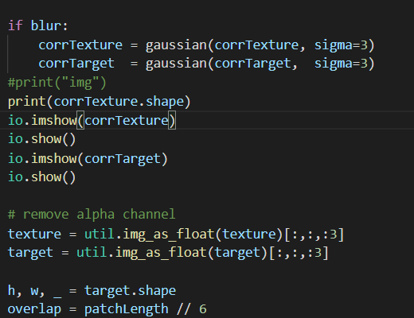
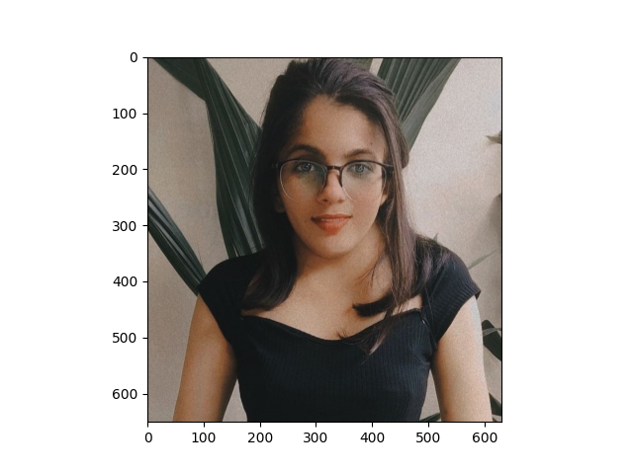
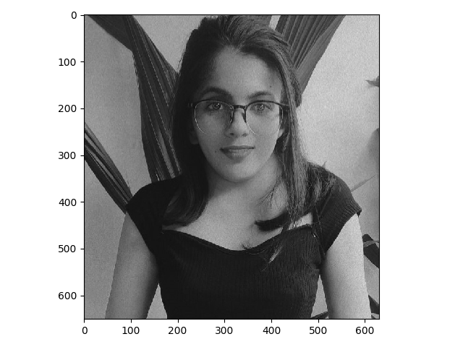

Results / Outputs
Texture Synthesis
We have used gaussian blur to make the image less noisy and then returned the texture synthesized image with overlap error having patchlength 25*25 i.e error is 1/6th of the patchlength
corrTexture and corrTarget converted from rgb to grayscale by using function rgb2Gray()

Slide 11
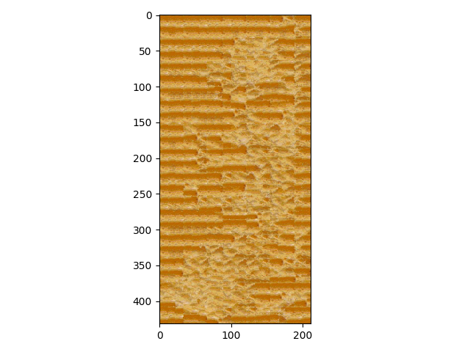
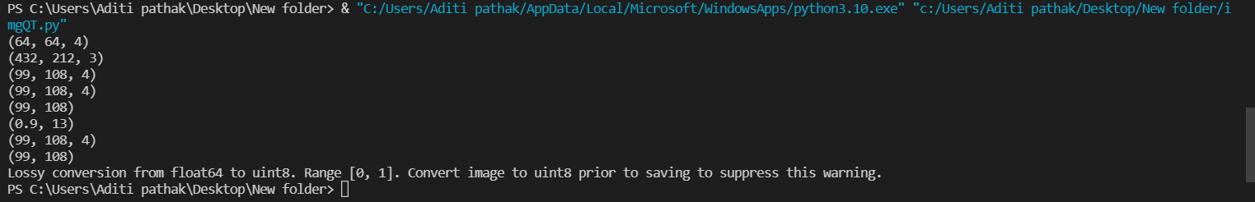
Anamoly Occuring
The image’s texture is too noisy and lossy conversion range from float64 to uint8 warning occurred. This is occurred because datatype of the image is changed during saving from original ‘float64’ to ‘uint8’.

Slide 12
Sessional Action Plan
SESSION 1
Discussion over implementation and collection of datasets or samples
Markov Property Justification
Minimum Error Boundary Cut
Blur gaussian for best correspondence patch and target selection
SESSION 2
Extracting blocks and fit them together for synthetic texture and transfer
Read Code functionalities from GitHub repositories.
Optimized the code and extended the algorithm of texture synthesis in texture transfer via image quilting.
Show simulations/results of how the desired requirements are meeting
SESSION 3
Rendering the texture of taken target to the target image
Source modification of the code.
Try different datasets or target images and patches for different outputs and results.
Finally present the output.

